Slide 1
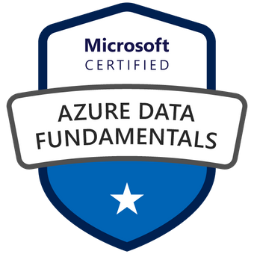

Exam DP-900: Microsoft Azure Data Fundamentals Crash Course
Tim Warner

Slide 2


Tim Warner
Based in Nashville, TN, US
Central time zone
MCT, MVP
Twitter: @TechTrainerTim
Badge: TechTrainerTim.com

Slide 3
Day 1 of 2 Agenda
Introduction
Identity and Security Design
Storage Data Design
Monitoring Design

Slide 4
Day 2 of 2 Agenda
Content catch-up
Business Continuity Design
Infrastructure Design
Exam AZ-304 strategy

Slide 5
Course Materials
timw.info/dp900

Slide 6
A Different Kind of Training
We'll learn by doing – at least 80 percent demo
Visual, case study approach
This is an expert certification, so we will move quickly and assume intermediate-level Azure skills
5-minute break at midpoint
I’m here to answer your questions – take advantage of this!
Use the Q&A panel

Slide 7

Session Recordings

Slide 8
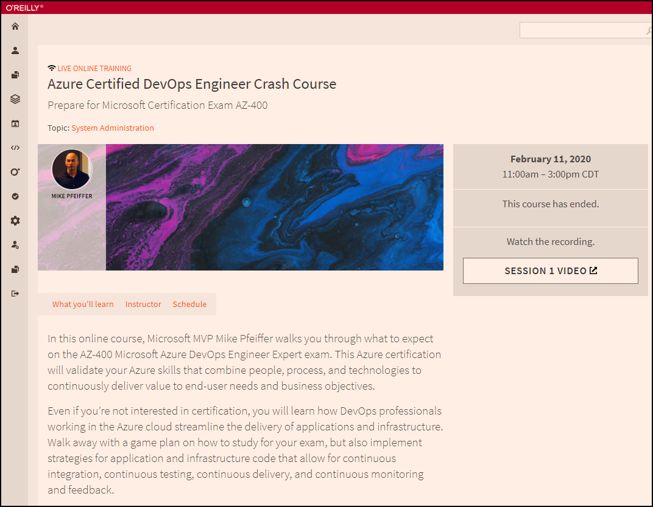
Session Recordings

Slide 9

Session Recordings

Slide 10
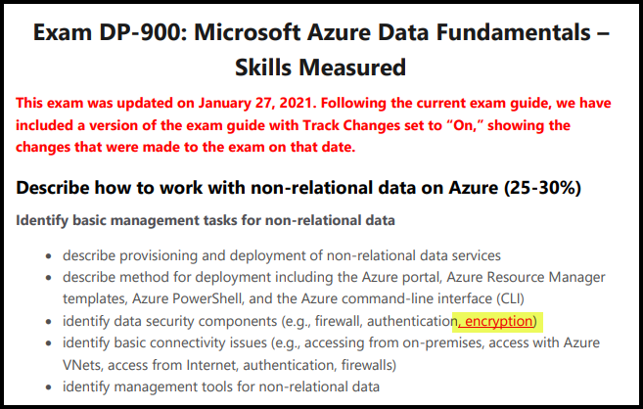
DP-900 Changes: January 27, 2021

Slide 11
Tim's Certification Study Pyramid
Interdependence
Content knowledge
Practical application
Test-taking skills

Slide 12
Thank you!
Course materials: timw.info/dp900
Twitter: @TechTrainerTim
Work: timw.info/ps
Web: TechTrainerTim.com

Slide 13
Topic

Slide 14
Exam DP-900 Item Types

Slide 15

Multiple Choice

Slide 16
Repeated Scenario
You need to move an Azure VM to another hardware host.
Solution: You redeploy the VM.
Does this solution meet the goal?
Yes
No

Slide 17

Select and Place

Slide 18

Build List and Reorder

Slide 19

Active Screen/Fill in the Blank

Slide 20

Case Study

Slide 21






Performance-Based Lab

Slide 22
Microsoft Online Testing

Slide 23
Microsoft Online Testing Process
timw.info/online

Slide 24

Microsoft Online Testing Process

Slide 25

Microsoft Online Testing Process

Slide 26

Microsoft Online Testing Process

Slide 27

Microsoft Online Testing Process

Slide 28

Microsoft Online Testing Process

Slide 29

Microsoft Online Testing Process

Slide 30

Microsoft Online Testing Process

